Slide 1
Introduction to statistical shape analysis II: Semi-landmarks and beyond
Sara Rolfe
8/26/19

Slide 2
Outline
How many landmarks are enough?
Semi-landmarks
Deformable Analysis
Spherical Harmonic Representation

Slide 3
How many landmarks are enough to characterize shape and size variation?
Criteria for landmarks to be homologous and reproducible results in very sparse data from images
For many data sets, this may not be sufficient to capture shape changes, especially along curves or smooth surfaces
Point-landmark too stringent for effective biometrics in many 3D applications
Watanabe, Akinobu. "How many landmarks are enough to characterize shape and size variation?." PloS one 13.6 (2018): e0198341.

Slide 4
How many landmarks are enough to characterize shape and size variation?
Criteria for landmarks to be homologous and reproducible results in very sparse data from images
For many data sets, this may not be sufficient to capture shape changes, especially along curves or smooth surfaces
Point-landmark too stringent for effective biometrics in many 3D applications
Image data provides rich phenotype descriptions – how can this be leveraged?
Watanabe, Akinobu. "How many landmarks are enough to characterize shape and size variation?." PloS one 13.6 (2018): e0198341.

Slide 5
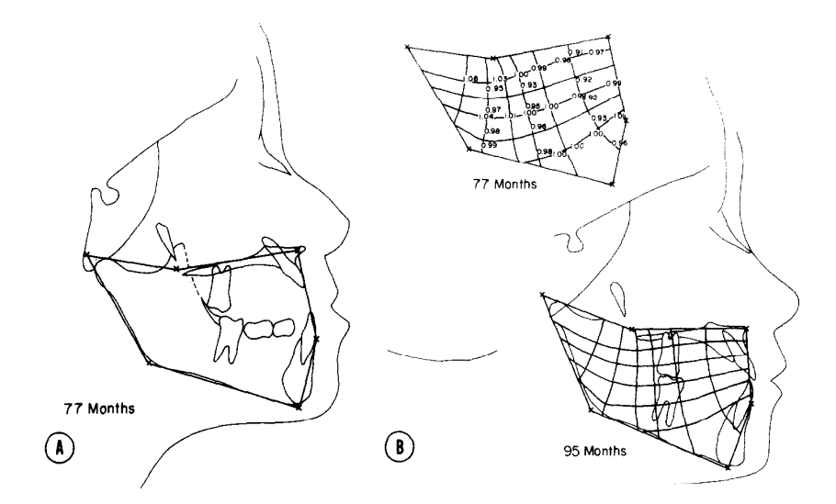
Constructed landmarks
Geometric combinations of defined landmarks along lines erected at specific angles to define new landmarks
Discarded since homology could not be fulfilled by these points
Moyers, Robert E., and Fred L. Bookstein. "The inappropriateness of conventional cephalometrics." American Journal of Orthodontics and Dentofacial Orthopedics 75.6 (1979): 599-617.

Slide 6
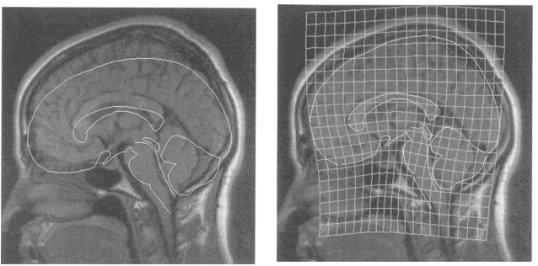
Extensions of TPS to include curvature
Bookstein, Fred L., and William DK Green. "A feature space for edgels in images with landmarks." Journal of Mathematical imaging and vision 3.3 (1993): 231-261.

Slide 7
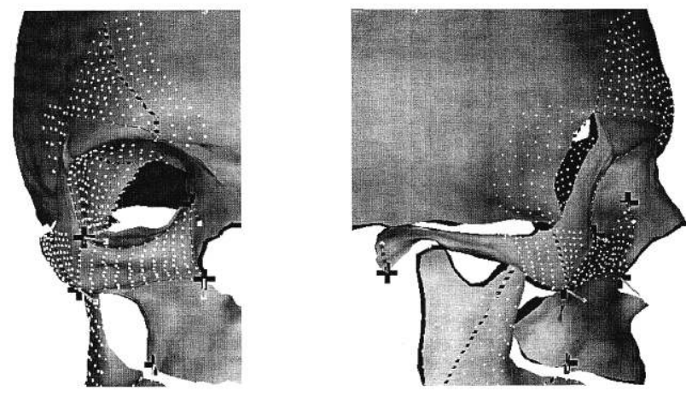
Smooth surface analysis
Cutting, C, et al. “A Three-Dimensional Smooth Surface Analysis of Untreated Crouzon's Syndrome in the Adult.” The Journal of Craniofacial Surgery., vol. 6, no. 6, 1995, pp. 444–453.
Cutting, C, et al. “A Three-Dimensional Smooth Surface Analysis of Untreated Crouzon's Syndrome in the Adult.” The Journal of Craniofacial Surgery., vol. 6, no. 6, 1995, pp. 444–453.
Cutting, C, et al. “A Three-Dimensional Smooth Surface Analysis of Untreated Crouzon's Syndrome in the Adult.” The Journal of Craniofacial Surgery., vol. 6, no. 6, 1995, pp. 444–453.
Cutting, C, et al. “A Three-Dimensional Smooth Surface Analysis of Untreated Crouzon's Syndrome in the Adult.” The Journal of Craniofacial Surgery., vol. 6, no. 6, 1995, pp. 444–453.
Combines the idea of constructed landmarks with previous work on parametric averaging of surfaces
Thin-plate spline unwarping to the Procrustes mean configuration
Equally spaced points are declared homologous along ridge curves and geodesics
Evenly spaced points are declared homologous on the surface patches
Cutting, Court, et al. "A three-dimensional smooth surface analysis of untreated Crouzon's syndrome in the adult." The Journal of craniofacial surgery 6.6 (1995): 444-453.

Slide 8
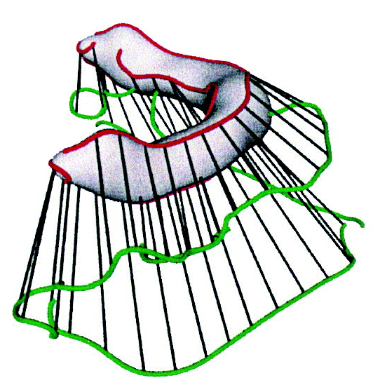
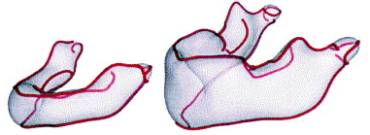
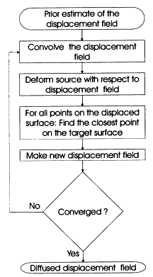
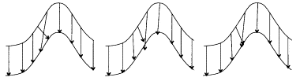
Geometry constrained diffusion
Ridge lines, characterized by a minimax property of directional surface curvature, are extracted
Curves are matched in order to establish object correspondence
Correspondences subject to constraints
Andresen, Per Rønsholt, and Mads Nielsen. "Non-rigid registration by geometry-constrained diffusion." Medical Image Analysis 5.2 (2001): 81-88.

Slide 9
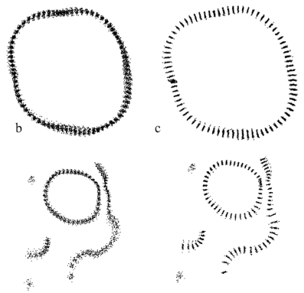
Sliding semi-landmarks
Begin with structures that are known to correspond as parts (classical homology)
Represents them by geometric curves or surfaces that generate reasonable mapping functions
After Procrustes superimposition, semi-landmarks are slid along the surface to optimize correspondences
Before and after semi-landmark
alignment of skull

Slide 10
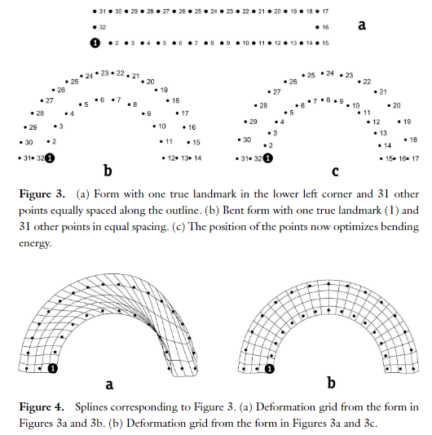
What is wrong with equidistant samples?
Produce spacing as a by-product of the analysis since the analysis is ignorant of the actual spacing.
Gunz, Philipp, Philipp Mitteroecker, and Fred L. Bookstein. "Semilandmarks in three dimensions." Modern morphometrics in physical anthropology. Springer, Boston, MA, 2005. 73-98.

Slide 11
Sliding semi-landmark method
Find optimal Procrustes alignment of samples using landmark points
Slide semi-landmark points along the surface until they satisfy matching criteria with a single reference specimen
Calculate Procrustes average shape
Slide semi-landmark points along the surface until they satisfy matching criteria with the Procrustes average
Repeat steps 3 and 4 until convergence
Bookstein, Fred L. "Landmark methods for forms without landmarks: morphometrics of group differences in outline shape." Medical image analysis 1.3 (1997): 225-243.

Slide 12
Determining position of sliding semi-landmarks
Minimum bending energy criterion: select semi-landmark positions that result in the smoothest possible transformation to the mean shape
Procrustes distance criterion: estimate the tangent to the mean surface for each semi-landmark point and remove the component of the difference between the mean and each specimen that lies along this tangent.

Slide 13
Minimum bending energy criteria
Individual surface
Mean surface

Slide 14
Minimum bending energy criteria
Find the line or plane tangent to the surface at the landmark point.
Individual surface
Mean surface

Slide 15
Minimum bending energy criteria
Slide along the surface’s tangent structure to the position minimizing the bending energy of the transform between the individual and mean shape.
Individual surface
Mean surface

Slide 16
Minimum bending energy criteria
Slide along the surface’s tangent structure to the position minimizing the bending energy of the transform between the individual and mean shape.
Individual surface
Mean surface

Slide 17
Minimum bending energy criteria
Project the point back to the point back to the surface.
Individual surface
Mean surface

Slide 18
Procrustes distance criteria
Individual surface
Mean surface

Slide 19
Procrustes distance criteria
Find the normal vector of the reference surface at the landmark point.
Individual surface
Mean surface

Slide 20
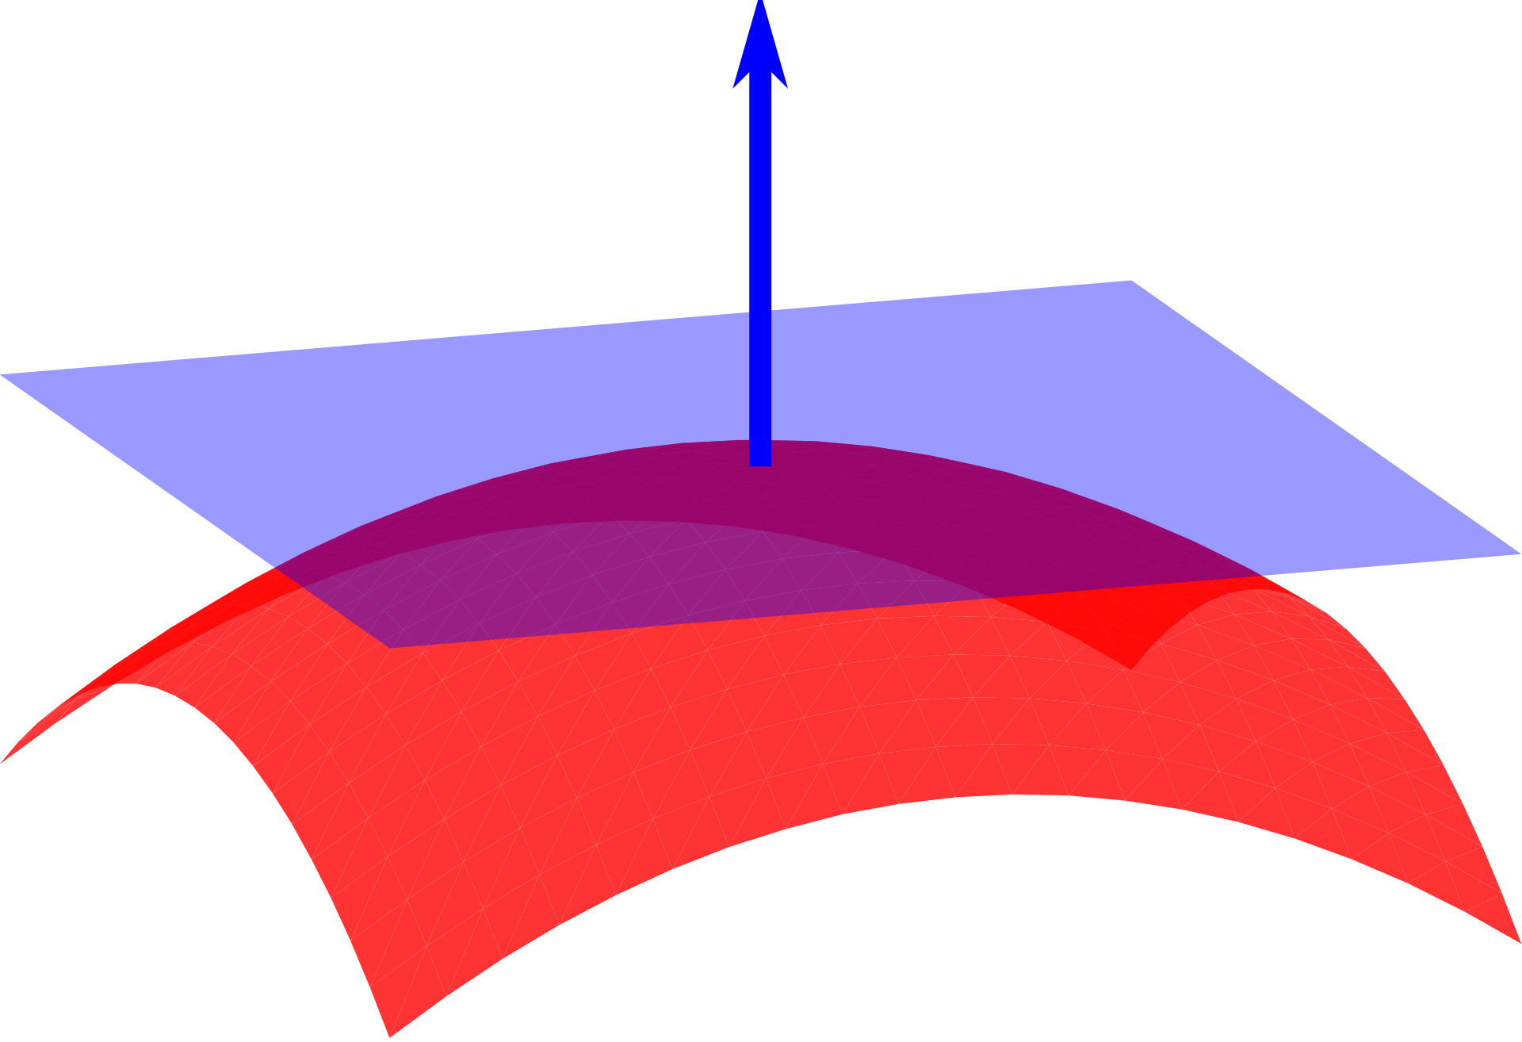
Procrustes distance criteria
Find the normal vector of the reference surface at the landmark point.
Individual surface
Mean surface
normal vector
A normal vector points in the
direction perpendicular to the
tangent plane at a point on the surface.
tangent plane
surface

Slide 21
Procrustes distance criteria
Slide the semi-landmark towards the reference surface normal vector.
Individual surface
Mean surface

Slide 22
Procrustes distance criteria
Slide the semi-landmark towards the reference surface normal vector.
Individual surface
Mean surface

Slide 23
Minimum bending energy or Procrustes distance?
Use different background assumptions
The difference between the criteria can alter the results when morphological variation in the sample is low
More noticeable with smaller numbers of semi-landmarks
Perez, S. Ivan, Valeria Bernal, and Paula N. Gonzalez. "Differences between sliding semi‐landmark methods in geometric morphometrics, with an application to human craniofacial and dental variation." Journal of anatomy 208.6 (2006): 769-784.

Slide 24

Limitations of semi-landmarks
Limited homology
The method of handling semi-landmarks can influence the results
The number of semi-landmarks may also influence the results
Semi-landmark positions are dependent on the dataset. Not possible to compare new shapes without recalculating

Slide 25
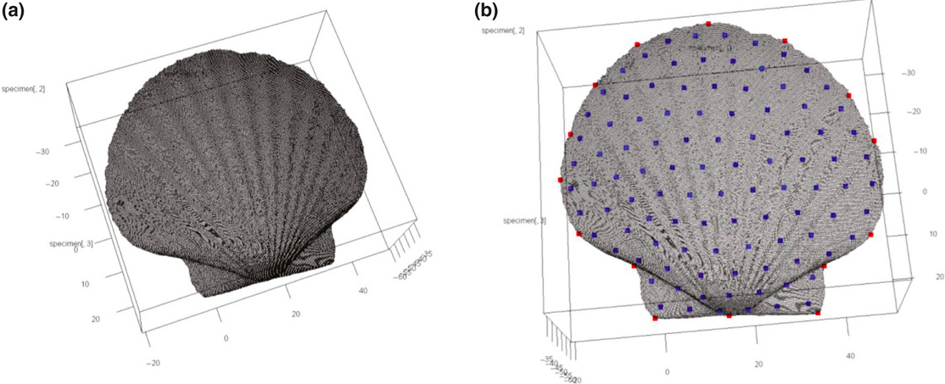
Semi-landmarks in R: Morpho
R Toolboxes Morpho and Geomorph for morphometric analysis provide support for capturing and analyzing semi-landmakrs

Slide 26
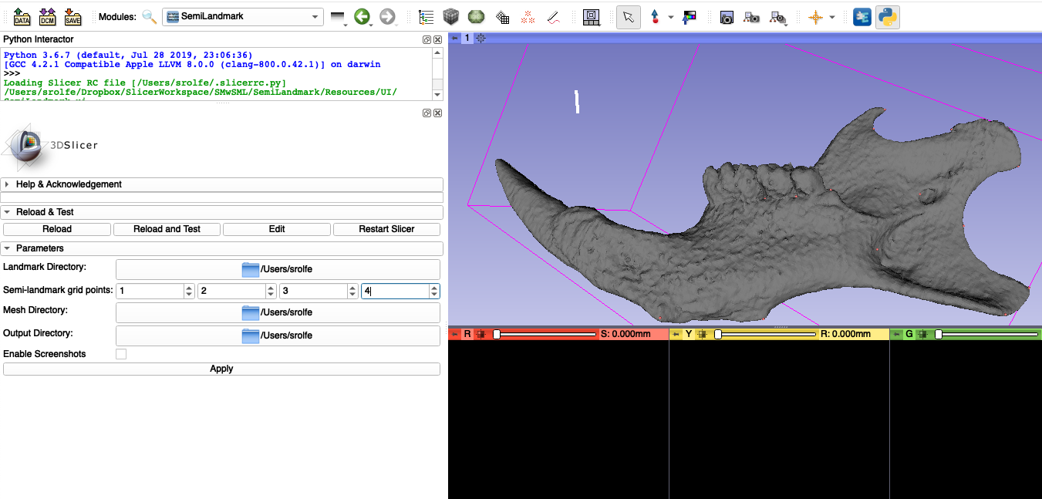
Coming soon

Slide 27
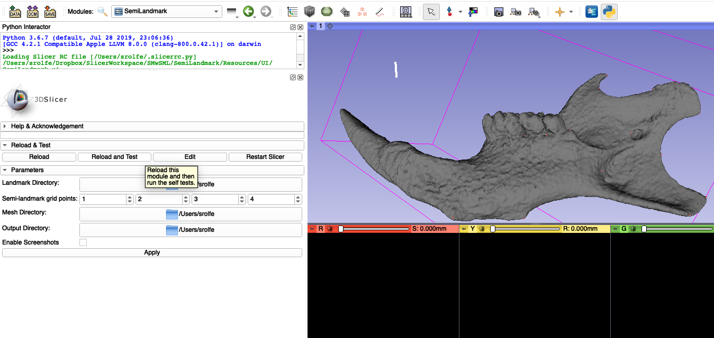
Coming soon

Slide 28

Coming soon

Slide 29
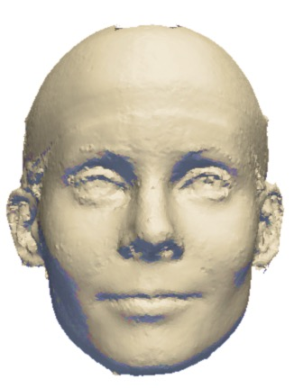
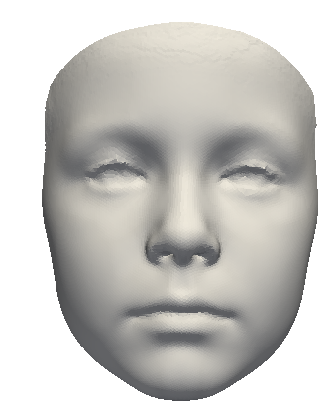
Deformation-based morphology (DBM)
Calculate or select a base mesh
Establish point correspondences between the base mesh and all meshes in data set
Vertices of the base mesh define a new set of dense surface landmarks
Base mesh
Sample image
Hutton, T. J., Buxton, B. F., Hammond, P. (2001). “Dense surface point distribution models of the human face,” in Proceedings IEEE Workshop on Mathematical Methods in Biomedical Image Analysis (MMBIA 2001) (Kauai, HI).
Notes:
To apply deformation-based morphology to analysis of human facial meshes, we used that was introduced by a group in 2001 and is now widely used to define the points of a base mesh as a set of dense landmarks and find correspondences for these mesh points across each image.

Slide 30
Steps to find point correspondence
Base mesh
Subject mesh
Notes:
The first step in the pcocess is to use GPA to align all anantomical landmarks. After this alignment, each subject mesh is warped to the base mesh using a thin plate spline transform. Once the base and subject meshes are very closely aligned, the correspondence for each vertex of the base mesh is found using the iterative closest point algorithm.

Slide 31
Steps to find point correspondence
Align anatomical landmarks with Generalized Procrustes Analysis (GPA)
Base mesh
Subject mesh
Notes:
The first step in the pcocess is to use GPA to align all anantomical landmarks. After this alignment, each subject mesh is warped to the base mesh using a thin plate spline transform. Once the base and subject meshes are very closely aligned, the correspondence for each vertex of the base mesh is found using the iterative closest point algorithm.

Slide 32
Steps to find point correspondence
Align anatomical landmarks with Generalized Procrustes Analysis (GPA)
Warp the meshes to a base mesh with a thin-plate spline (TPS) transformation
Base mesh
Subject mesh
Notes:
The first step in the pcocess is to use GPA to align all anantomical landmarks. After this alignment, each subject mesh is warped to the base mesh using a thin plate spline transform. Once the base and subject meshes are very closely aligned, the correspondence for each vertex of the base mesh is found using the iterative closest point algorithm.

Slide 33
Steps to find point correspondence
Align anatomical landmarks with Generalized Procrustes Analysis (GPA)
Warp the meshes to a base mesh with a thin-plate spline (TPS) transformation
Determine point correspondences for each vertex the iterative closest point (ICC) algorithm
Base mesh
Subject mesh
Notes:
The first step in the pcocess is to use GPA to align all anantomical landmarks. After this alignment, each subject mesh is warped to the base mesh using a thin plate spline transform. Once the base and subject meshes are very closely aligned, the correspondence for each vertex of the base mesh is found using the iterative closest point algorithm.

Slide 34
Steps to find point correspondence
Align anatomical landmarks with Generalized Procrustes Analysis (GPA)
Warp the meshes to a base mesh with a thin-plate spline (TPS) transformation
Determine point correspondences for each vertex the iterative closest point (ICC) algorithm
Each vertices of the base mesh represents a landmark point with a known correspondences for each subject
Base mesh
Notes:
The first step in the pcocess is to use GPA to align all anantomical landmarks. After this alignment, each subject mesh is warped to the base mesh using a thin plate spline transform. Once the base and subject meshes are very closely aligned, the correspondence for each vertex of the base mesh is found using the iterative closest point algorithm.

Slide 35
Steps to find point correspondence
Align anatomical landmarks with Generalized Procrustes Analysis (GPA)
Warp the meshes to a base mesh with a thin-plate spline (TPS) transformation
Determine point correspondences for each vertex the iterative closest point (ICC) algorithm
Each vertices of the base mesh represents a landmark point with a known correspondences for each subject
The TPS warped subjects need to be a reasonable approximation of the mean shape
This depends on the number of alignment landmarks and the variation in the data set
Base mesh
Notes:
The first step in the pcocess is to use GPA to align all anantomical landmarks. After this alignment, each subject mesh is warped to the base mesh using a thin plate spline transform. Once the base and subject meshes are very closely aligned, the correspondence for each vertex of the base mesh is found using the iterative closest point algorithm.

Slide 36
DBM is not “landmark-free”
Initial alignment defines the frame of reference
Choice of landmarks for alignment will impact the interpretation of the results
Alignment landmarks with known homology will provide an interpretable framework for shape change measured
Alignment landmarks
Subject mesh
Base mesh
Base mesh
Subject mesh
Alignment landmarks

Slide 37
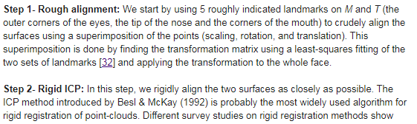
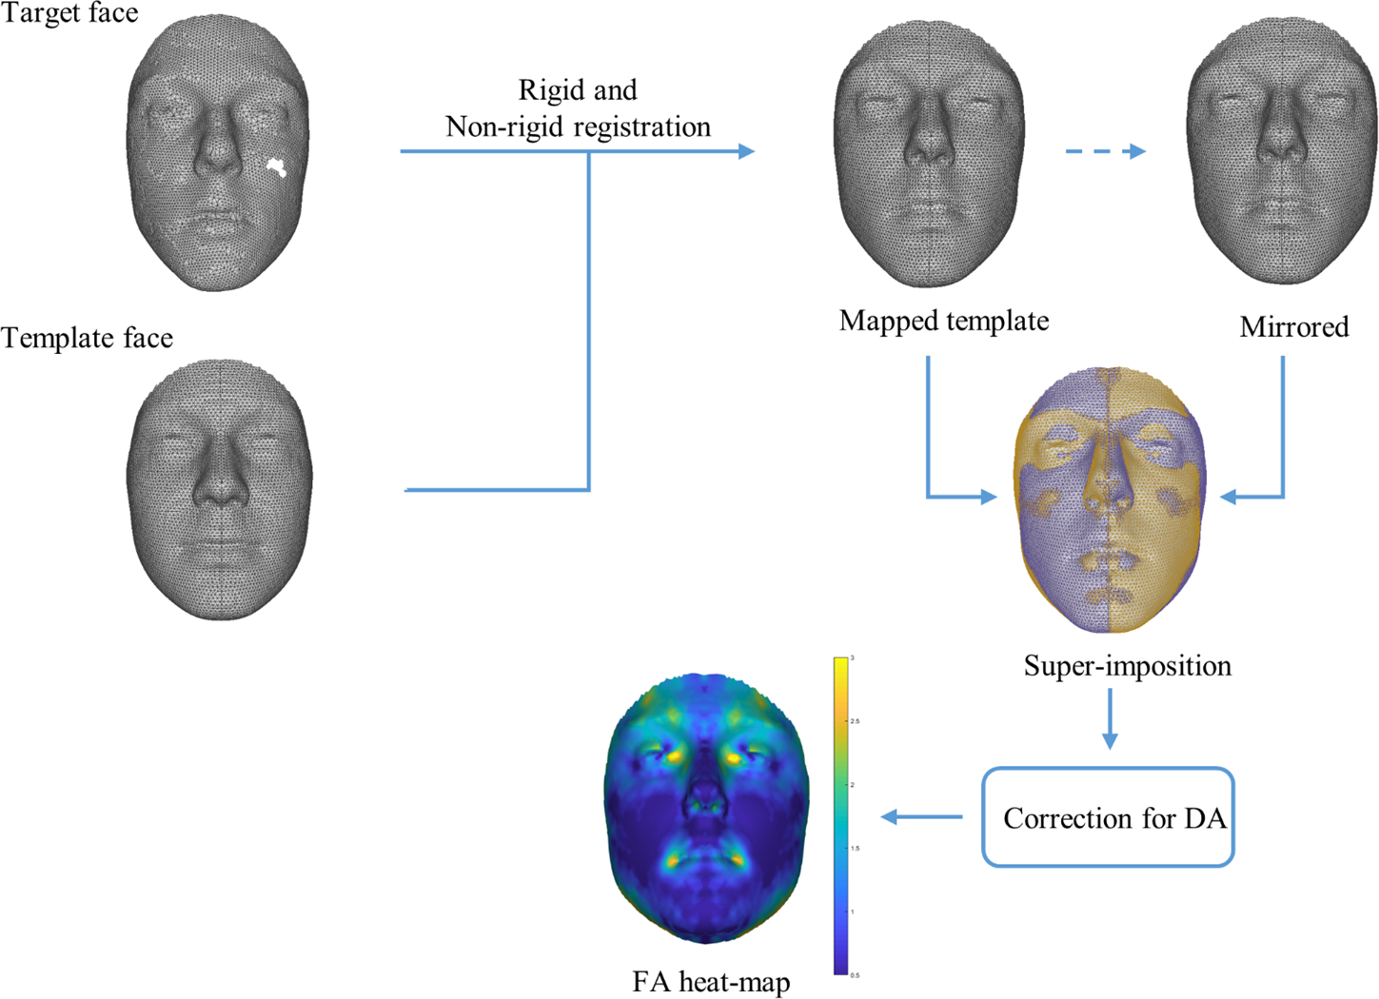
Initial alignment in DBM
Ekrami, Omid, et al. "Measuring asymmetry from high-density 3D surface scans: An application to human faces." PloS one13.12 (2018): e0207895.

Slide 38
Initial alignment in DBM
Approximate landmarks followed by automated alignment result in a reference frame that’s challenging to interpret
Method and choice of landmarks should be carefully evaluated
Ekrami, Omid, et al. "Measuring asymmetry from high-density 3D surface scans: An application to human faces." PloS one13.12 (2018): e0207895.

Slide 39
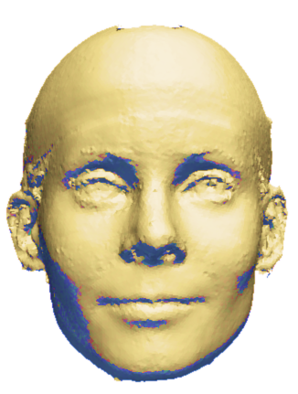
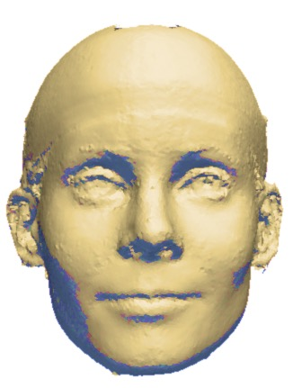
Dense model of facial asymmetry
Flow Vector
Atlas
Sample original image
Sample mirror image
Notes:
Deformable morphology techniques can be used to generate a description of an individuals asymmetry by warping both a subject’s facial mesh and its mirrored copy to the base mesh. The flow vector defined between the corresponding points on the image and its mirror copy describe the transformation between corresponding points on each side of the face.

Slide 40
Quantifying facial asymmetry with Dense Surface Models
3D surface images
Calculate corresponding points
GPA,TPS, ICP
Feature heat maps
Feature
extraction
Feature extraction
Magnitude of flow vectors
Summarize local features
Summarize
local features
Global score
Average transform magnitude or RMS error
Principal modes of variation
Facial signatures (Hammond et al., 2012)
BRIM method (Claes et al., 2014)
Notes:
Deformation based-analysis of the asymmetry of an individual can be found by taking the dense field of flow vectors for each image, extract features from this vector field, and then summarize the spatial distribution of these features across the surface of the image. In recent work using deformation based morphometrics, the feature extracted was the flow vector magnitude. Several methods have been used to summarize the feature distribution over the image surface including

Slide 41
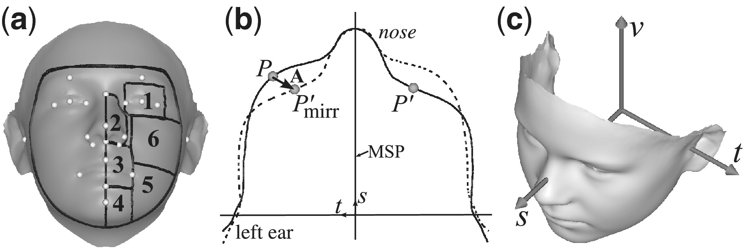
Automated Quantification of facial asymmetry
Darvann, Tron A., et al. "Automated quantification and analysis of facial asymmetry in children with arthritis in the temporomandibular joint." 2011 IEEE International Symposium on Biomedical Imaging: From Nano to Macro. IEEE, 2011.

Slide 42
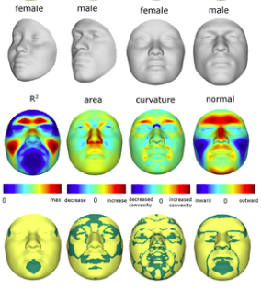
BRIM: bootstrapped response-based imputation modeling
Technique to investigate the genetic basis for variation in the shape of the human face
Estimation of a single quantitative axis of variation correspond to effects of single genes, ancestry, or sex
Claes, Peter, et al. "Modeling 3D facial shape from DNA." PLoS genetics 10.3 (2014): e1004224.
Hallgrimsson, Benedikt, et al. "Let's face it—complex traits are just not that simple." PLoS genetics 10.11 (2014): e1004724.
Notes:
Evaluated 46 genes based on evidence of accelerated evolution and evidence from animal models that these genes are expressed in the head

Slide 43
BRIM: bootstrapped response-based imputation modeling
Technique to investigate the genetic basis for variation in the shape of the human face
Estimation of a single quantitative axis of variation correspond to effects of single genes, ancestry, or sex
“…our methods provide the means of identifying the genes that affect facial shape and for modeling the effects of these genes to generate a predicted face.”
Claes, Peter, et al. "Modeling 3D facial shape from DNA." PLoS genetics 10.3 (2014): e1004224.
Hallgrimsson, Benedikt, et al. "Let's face it—complex traits are just not that simple." PLoS genetics 10.11 (2014): e1004724.
Notes:
Evaluated 46 genes based on evidence of accelerated evolution and evidence from animal models that these genes are expressed in the head

Slide 44
Summarizing local features
3D surface images
Calculate corresponding points
GPA,TPS, ICP
Feature heat maps
Feature
extraction
Feature
extraction
Feature extraction
Magnitude of flow vectors
Angle of flow vectors
Local shape descriptors
Summarize local features
Global-plus-local similarity metric
Model of normal asymmetry
Summarize
local features
Global score
Notes:
Then, these local features are summarized using our method of quantifying the distance of each individual from a model of normal asymmetry,

Slide 45
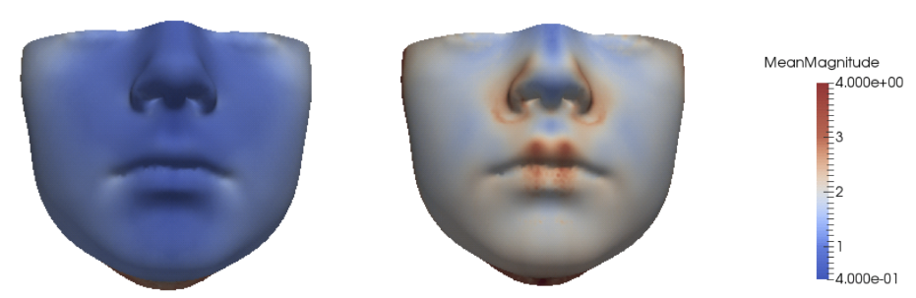
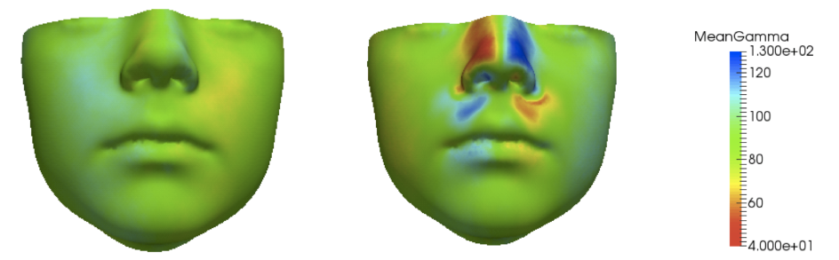
Feature Heat Maps
Magnitude Feature
Angle of deformation
Average of normal asymmetry
Abnormal Asymmetry
Notes:
The local features are calculated at each mesh vertex and can be displayed as a heat map of scalar values for each feature. This slide shows how normal asymmetry differs from an abnormal case for the magnitude and angle of deformation feature.

Slide 46
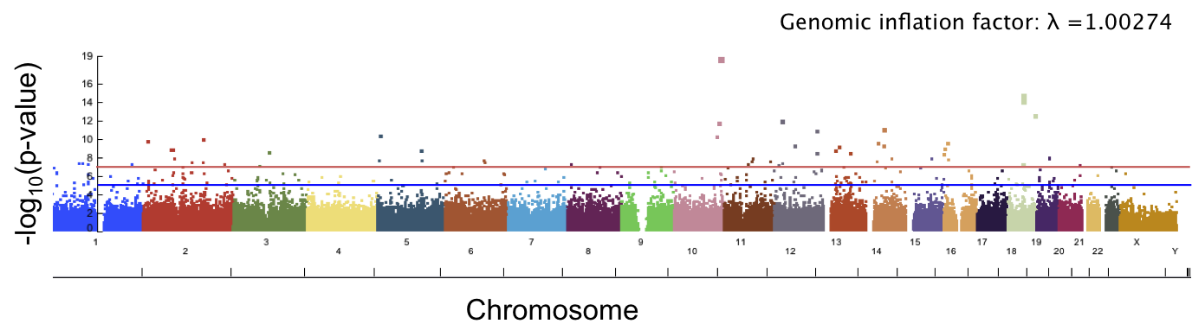
Genetic basis of facial asymmetry
Aim to use automated phenotyping to produce a score of facial asymmetry that can summarize local deviations from normal asymmetry
Correlate with SNP data to investigate genetic basis of asymmetry
Normal angle difference
Rolfe, Sara, Su-In Lee, and Linda Shapiro. "Associations between genetic data and quantitative assessment of normal facial asymmetry." Frontiers in genetics 9 (2018): 659.
Notes:
Framework for automated phenotyping that can score how subjects differ from normal asymmetry and correlate those differences with SNP data.

Slide 47
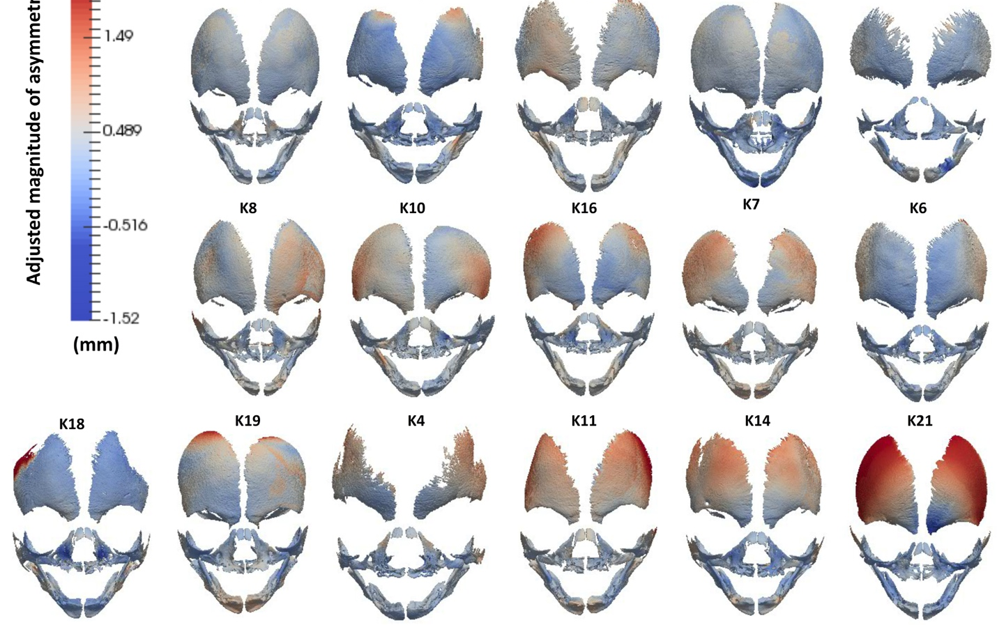
Analysis of asymmetry in developing facial bones
Katsube, M., Rolfe, S.M., Bortolussi, S.R., Yamaguchi, Y., Richman, J.M., Yamada, S. and Vora, S.R., 2019. Analysis of facial skeletal asymmetry during foetal development using μCT imaging. Orthodontics & craniofacial research, 22, pp.199-206.
Notes:
In addition to these data sets, we have used these techniques on a variety of datasets including facial bones during development, where deformable shape analysis was used in addition to standard landmark based GM methods and provided additional information on smooth regions where landmark data was sparse.

Slide 48
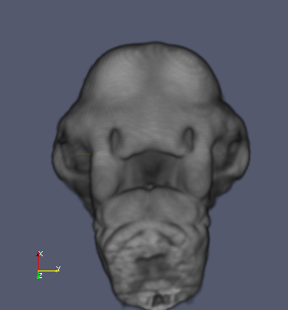
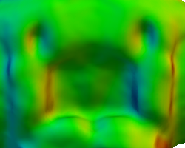
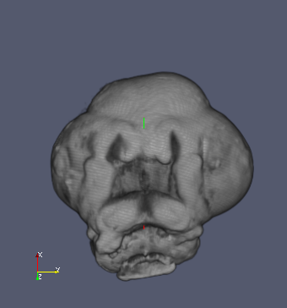
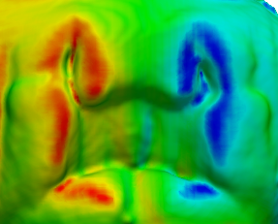
Feature Heat Maps
Zoom of Facial Region
Angle Heat Map
Normal Reference Image
(ii) (iv)
(i)
(iii) (v)

Slide 49
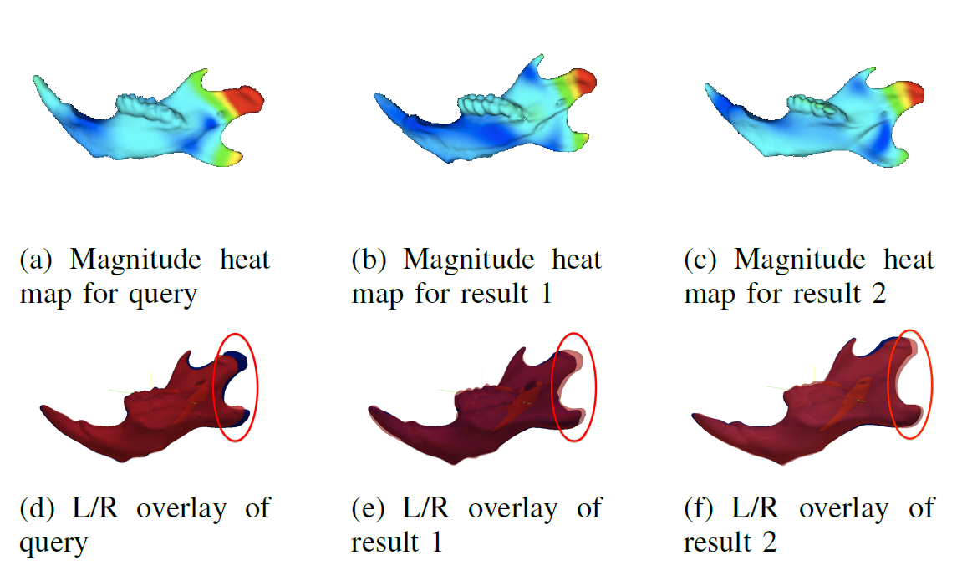
Retrieval of Specimen with Similar Morphological Shape Differences
Magnitude Sample Query
Magnitude Heat Map
Left/Right Overlay
(i) Query Image (ii) First Result (iii) Second Result
Correlation between distance from most asymmetric and expert asymmetry ranking = 0.91
Rolfe, S. M., Camci, E. D., Mercan, E., Shapiro, L. G., & Cox, T. C. "A New Tool for Quantifying and Characterizing Asymmetry in Bilaterally Paired Structures.“ IEEE EMBS ‘13 Jul 2013.
Normal Image
Cleft Image
Notes:
And while most of this talk has focused on human data, these methods are also suitable for use in animal models and we have adapted it to use voxel, rather than mesh data.

Slide 50
Limitations of DBM
No guarantee of homology
Results need to be interpreted with respect to initial alignment
High dimensional data output
Computationally intensive for large datasets

Slide 51
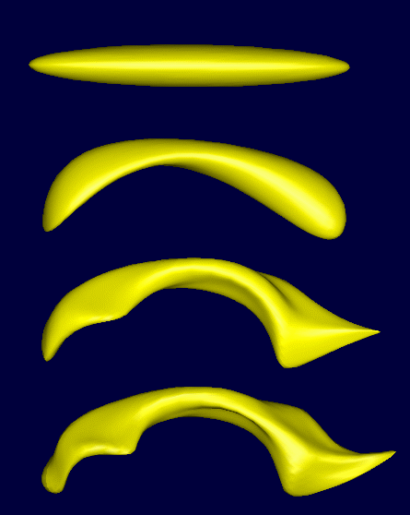
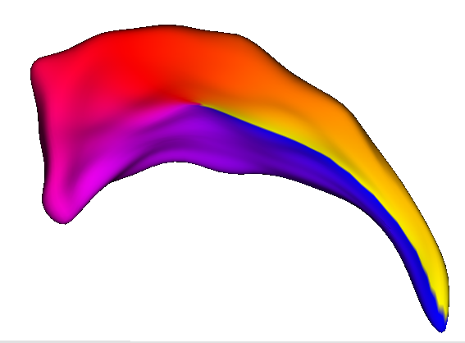
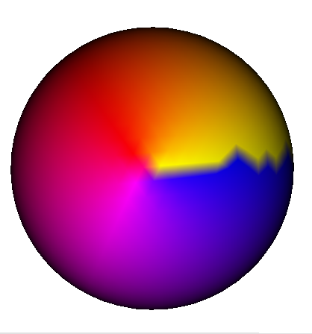
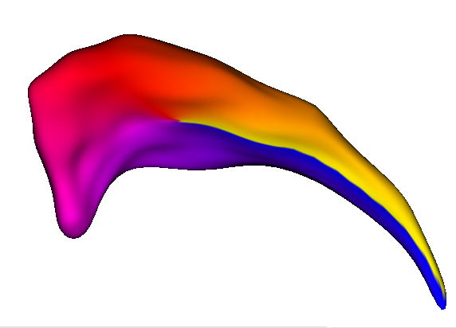
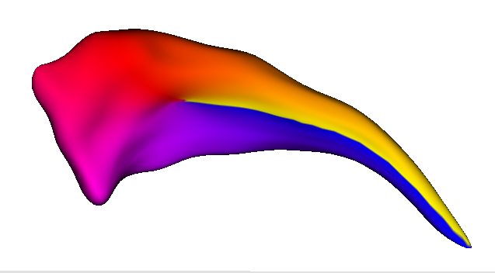
Spherical harmonic representation and point distributed models (SPHARM-PDM)
1
SPHARM description is computed from the mesh and its spherical parameterization
3
6
10
10
Styner, Lieberman, Pantazis, Gerig: Boundary and Medial Shape Analysis of the Hippocampus in Schizophrenia, Medical Image Analysis, 2004, pp 197-203
Notes:
Correspondence is computed by mapping every point on the mandibular 3D surface models to a unique position on the unit sphere. Surface parameterization is optimized to minimize area distortion.
Fit coefficients of parameterized basis functions to surface

Slide 52
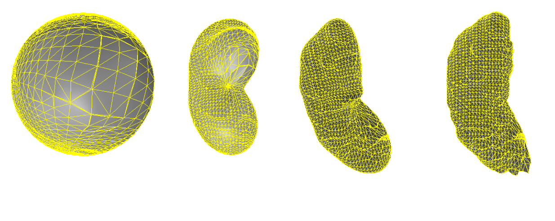
SPHARM modeling
Overfitting
degree 1
degree 5
degree 10
degree 50
The SPHARM description is then sampled into a triangulated surface
Triangulated surfaces with correspondences are computed via icosahedron of the spherical parameterization

Slide 53
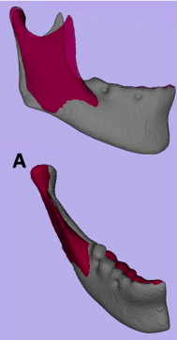
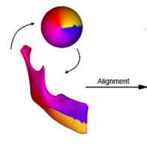
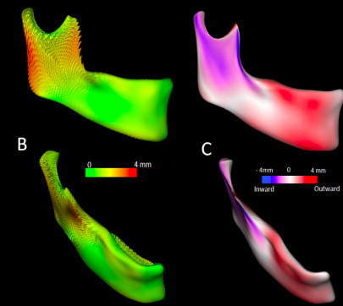
SPHARM analysis of mandibular asymmetry
Cevidanes, Lucia HS, et al. "Three-dimensional quantification of mandibular asymmetry through cone-beam computerized tomography." Oral Surgery, Oral Medicine, Oral Pathology, Oral Radiology, and Endodontology 111.6 (2011): 757-770.

Slide 54
Limitations of SPHARM methods
Requirement for spherical topology of meshes
Challenging for complicated or noisy data sets
Developed for high N of shapes with similar morphology – should preform a quality assessment to check for correspondence issues

Slide 55
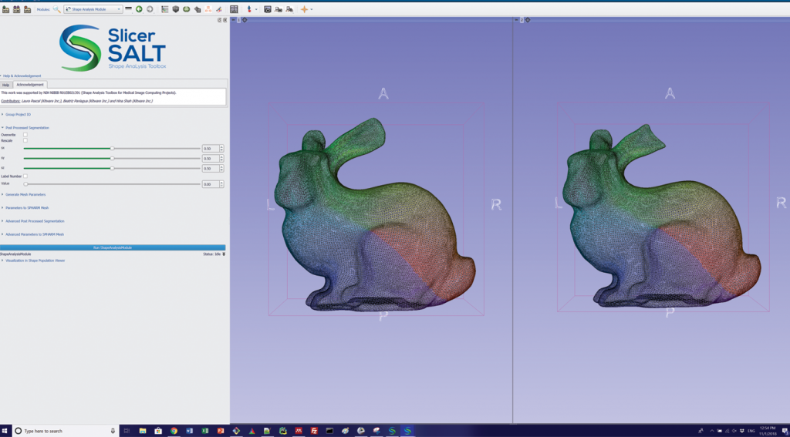
Slicer SALT: Shape AnaLysis Toolbox
Compute point distributed models (pdm) using spherical harmonic representation (SPHARM-PDM)

Slide 56
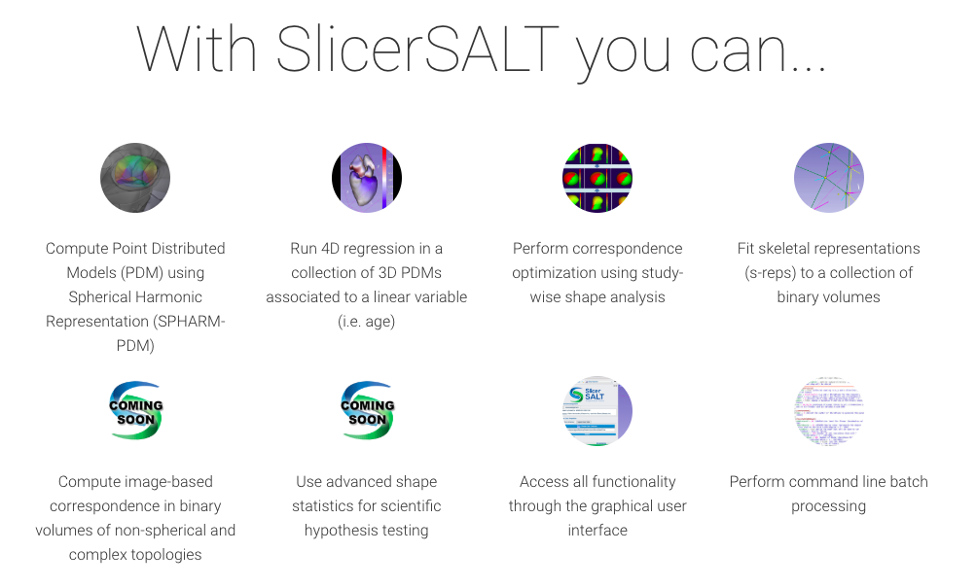
Coming soon

Slide 57
Questions?

Slide 58
Resources
Watanabe, Akinobu. "How many landmarks are enough to characterize shape and size variation?." PloS one 13.6 (2018): e0198341.
Moyers, Robert E., and Fred L. Bookstein. "The inappropriateness of conventional cephalometrics." American Journal of Orthodontics and Dentofacial Orthopedics 75.6 (1979): 599-617.
Bookstein, Fred L., and William DK Green. "A feature space for edgels in images with landmarks." Journal of Mathematical imaging and vision 3.3 (1993): 231-261.
Cutting, Court, et al. "A three-dimensional smooth surface analysis of untreated Crouzon's syndrome in the adult." The Journal of craniofacial surgery 6.6 (1995): 444-453.
Andresen, Per Rønsholt, and Mads Nielsen. "Non-rigid registration by geometry-constrained diffusion." Medical Image Analysis 5.2 (2001): 81-88.
Gunz, Philipp, Philipp Mitteroecker, and Fred L. Bookstein. "Semilandmarks in three dimensions." Modern morphometrics in physical anthropology. Springer, Boston, MA, 2005. 73-98.
Perez, S. Ivan, Valeria Bernal, and Paula N. Gonzalez. "Differences between sliding semi‐landmark methods in geometric morphometrics, with an application to human craniofacial and dental variation." Journal of anatomy 208.6 (2006): 769-784.
Ekrami, Omid, et al. "Measuring asymmetry from high-density 3D surface scans: An application to human faces." PloS one13.12 (2018): e0207895.
Darvann, Tron A., et al. "Automated quantification and analysis of facial asymmetry in children with arthritis in the temporomandibular joint." 2011 IEEE International Symposium on Biomedical Imaging: From Nano to Macro. IEEE, 2011.
Styner, Lieberman, Pantazis, Gerig: Boundary and Medial Shape Analysis of the Hippocampus in Schizophrenia, Medical Image Analysis, 2004, pp 197-203

